Slide 1

Exploratory Data Analysis On
Web Scraped
Nykaa Products Data

Slide 2
ABOUT ME
NAME : M.SUPRATHIKA
Batch No : 386
Course : Data Scientist
Linkedin : https://www.linkedin.com/in/suprathika-malladhi-b2447b265
GitHub : https://github.com/suprathika404151/grocery-management-system

Slide 3
INTRODUCTION
Nykaa is one of India’s leading e-commerce platforms for beauty, wellness, and personal care products.
Offers products across categories like skincare, haircare, makeup, and body care.
Web scraping is used to collect real-time product information (name, price, brand, volume) from Nykaa’s website.
Collected data is stored in a structured format (CSV/DataFrame).
Exploratory Data Analysis (EDA) is performed to uncover:
Price distribution
Brand-wise product availability
Relationship between volume & price
The analysis helps in understanding market trends and consumer options available on Nykaa.

Slide 4
PROJECT OVERVIEW
Automate data extraction of product details from Nykaa using web scraping (Requests + BeautifulSoup).
Create a structured dataset containing product name, price, volume, and brand for analysis.
Clean and preprocess data by handling missing values, removing duplicates, and standardizing formats.
Perform Exploratory Data Analysis (EDA) to:
Analyze price distribution across products.
Study brand-wise product availability.
Understand relationship between price and volume.
Generate visual insights using charts (bar plots, histograms, scatter plots).
.

Slide 5
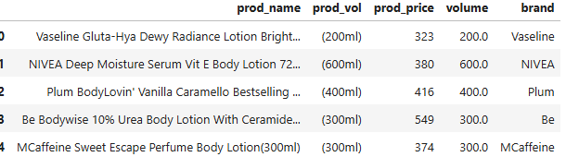
DATASET OVERVIEW
Total Records: 620 rows
Columns:
prod_name – Product Name (string)
prod_vol – Product Volume (text format, e.g., 200ml, 226g)
prod_price – Product Price (₹)
volume – Cleaned numeric volume (float, extracted from prod_vol)
Brand – Brand Name (string)
Key Observations:
Dataset contains products from multiple brands (Vaseline, NIVEA, Plum, MCaffeine, etc.)
56 missing values found in volume column (handled during data cleaning).

Slide 6
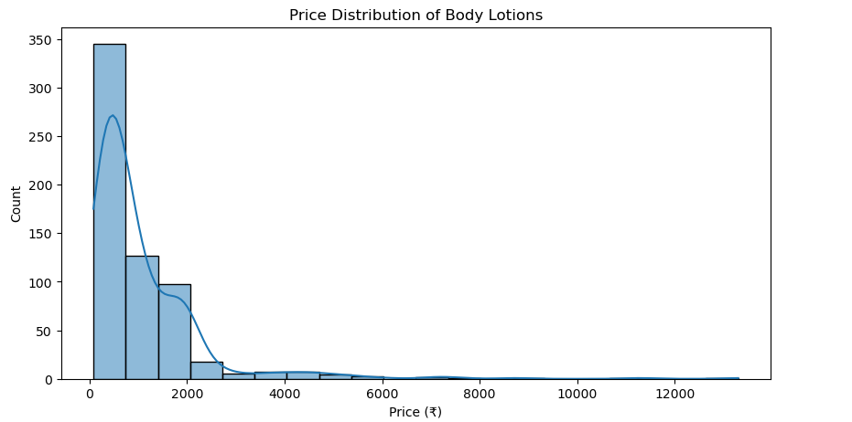
UNIVARIATE ANALYSIS
Majority of products are priced between ₹300 – ₹1500
(bulk of the distribution).
Clear right-skewness → most prices are on the lower end,
with few very high-priced items.
A long tail exists, showing premium products (above ₹5000)
but in very small counts.
Distribution shows clustered price ranges — many products
around ₹300-₹500 (budget segment).
Median price is lower than mean (due to skewness and high outliers).
Price data has some outliers, but they represent niche/premium
products rather than errors

Slide 7
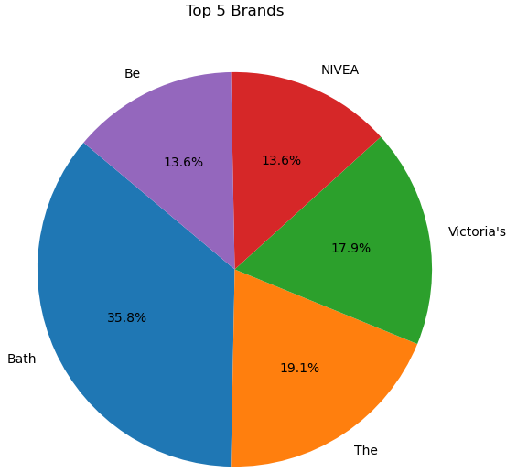
Top 5 Brands using pie chart
Bath brand dominates with ~36% share, making it the most common brand in the dataset.
The brand holds ~19% share, being the second most frequent.
Victoria’s contributes around 18%, showing strong presence.
Be and NIVEA are equally represented (~13.6% each).
The distribution shows that these 5 brands together form the majority of available products.
The top 5 brands together contribute more than 75% of the total dataset, showing a strong brand concentration.
There are many smaller brands outside the top 5 that hold minimal share — indicating high competition among niche players.

Slide 8
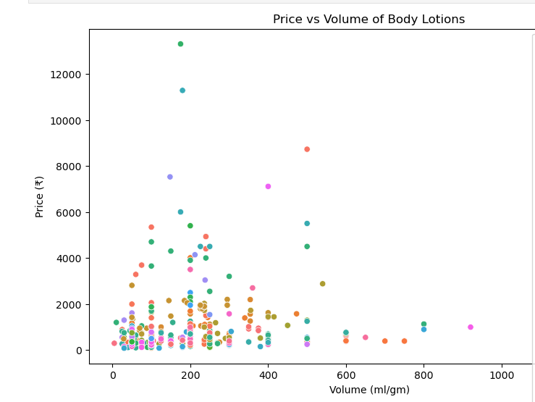
BIVARIATE ANALYSIS
There is no strong linear relationship between price and volume.
Products with similar volume have very different prices, indicating pricing depends on other factors (brand, ingredients, etc.).
Most products are clustered around 100ml – 400ml volume and ₹200 – ₹2000 price range.
Few products have very high prices (>₹5000) regardless of their volume — likely premium/luxury products.
Larger volumes (600ml–1000ml) are not always the most expensive — some are still in the affordable range.

Slide 9
INSIGHTS
Nykaa’s Body Lotion Range
Offers products across budget, mid-range, and premium segments.
Majority of products priced between ₹300 – ₹1500 → mass-market focus.
Brand Analysis
Bath brand dominates with the highest share (~36%).
Top 5 brands together contribute >75% of all listings, showing brand concentration.
Presence of many smaller brands shows high market competition.
Volume & Price Relationship
No strong correlation between price and volume — price influenced more by brand, ingredients, and product positioning.

Slide 10

THANK YOU

